Slide 1

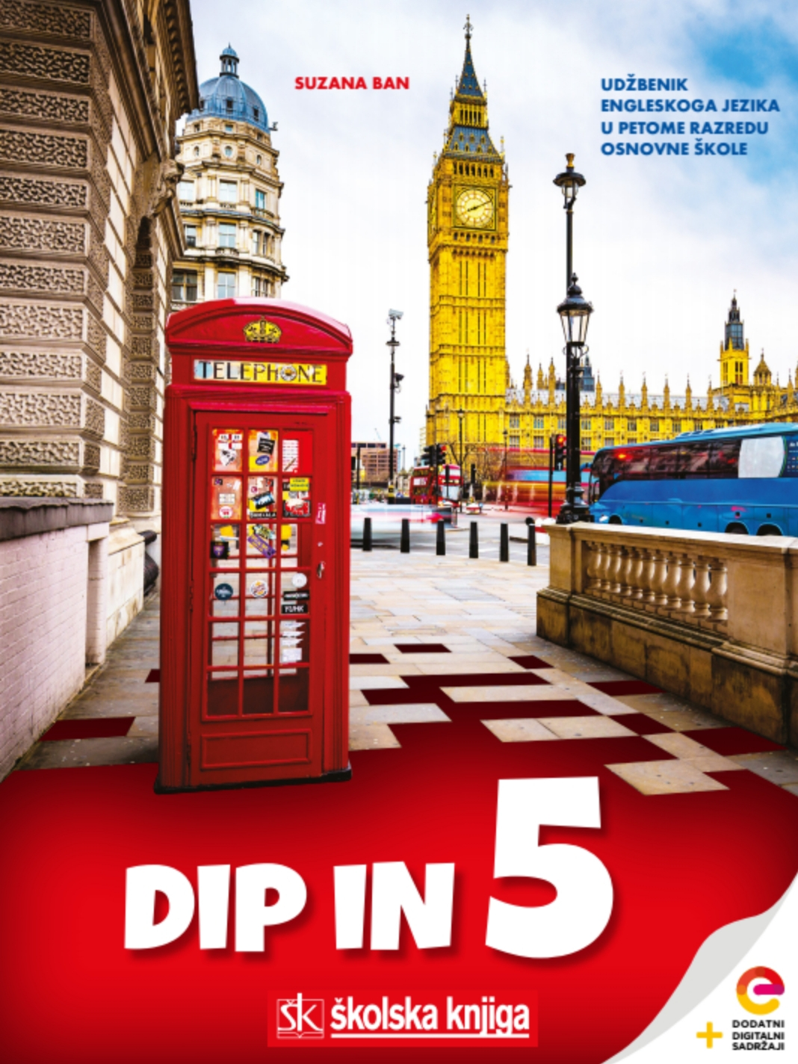

UNIT 6
Town and countryside
Home again

Slide 2
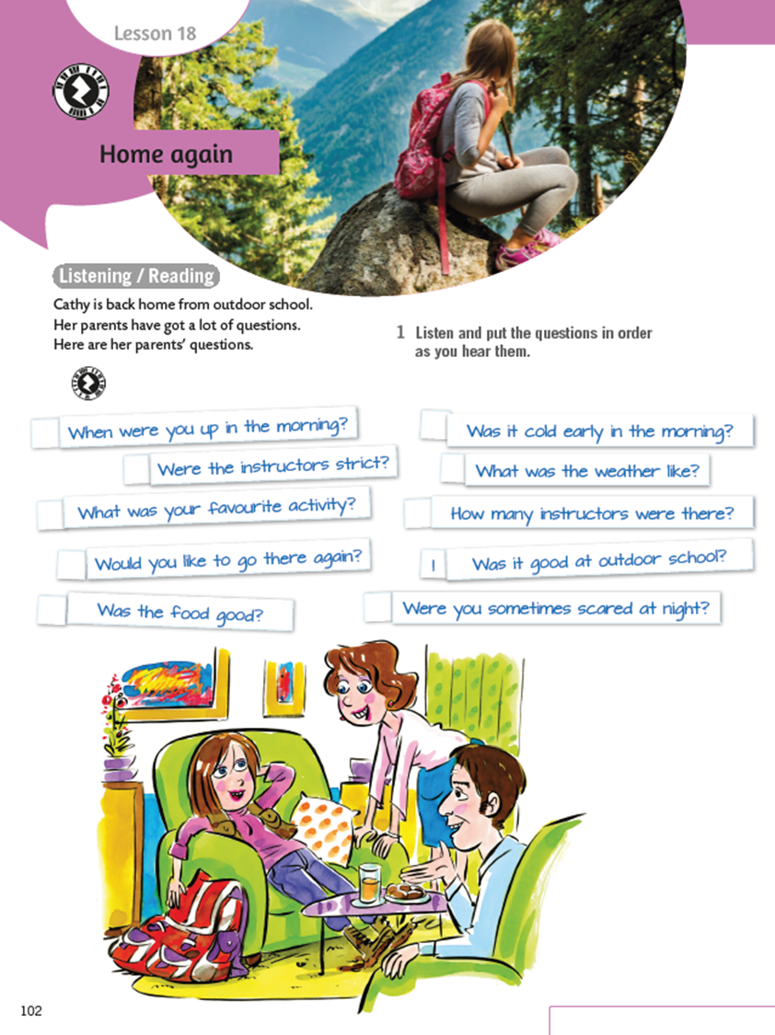

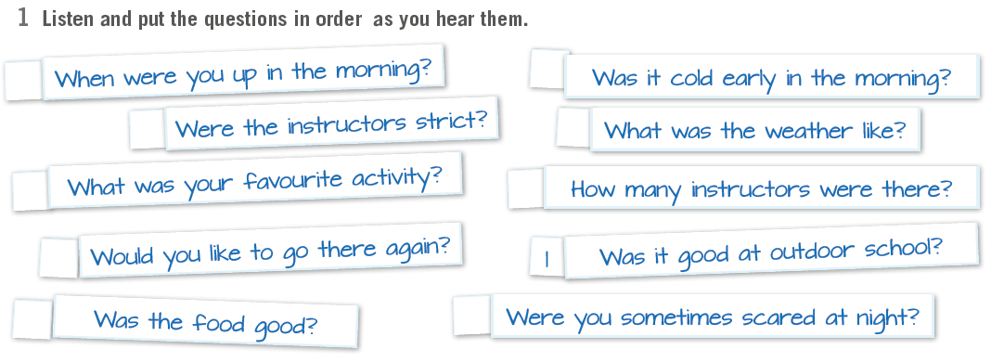
Book, page 102. Cathy is back home and her parents have got a lot of questions about her outdoor school experience.
Listen and put the questions in order as you hear them.
https://www.e-sfera.hr/dodatni-digitalni-sadrzaji/2d92afb2-639a-479a-9eba-cb25a93c4716/assets/audio/42-lesson_18_home_again_.mp3
7
8
5
9
3
4
10
2
6

Slide 3
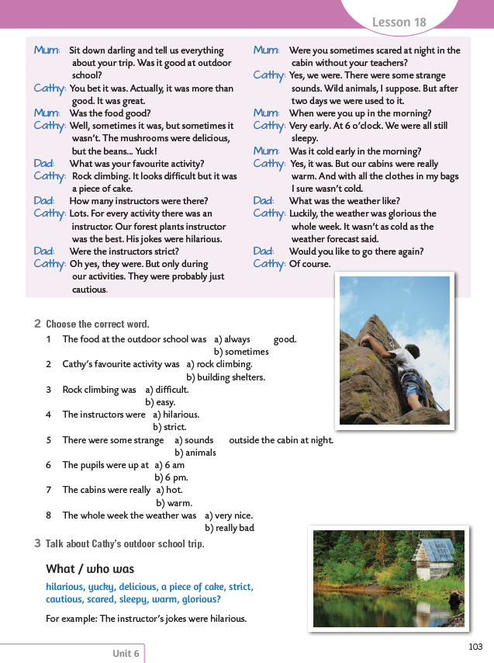
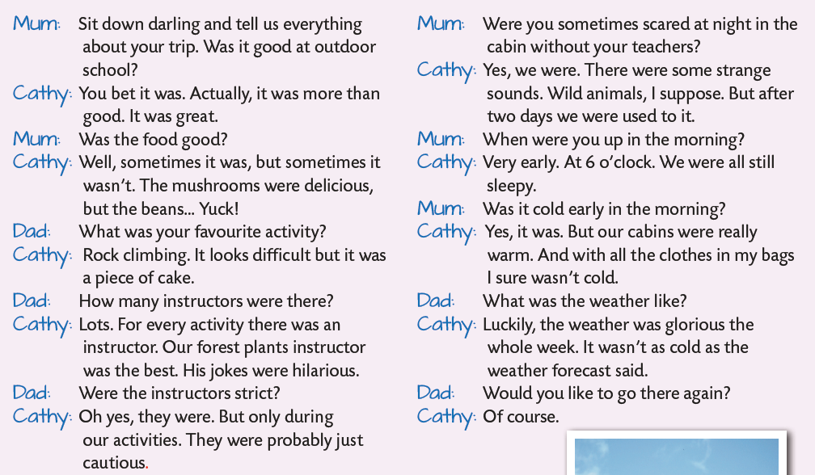
On the next page...

Slide 4
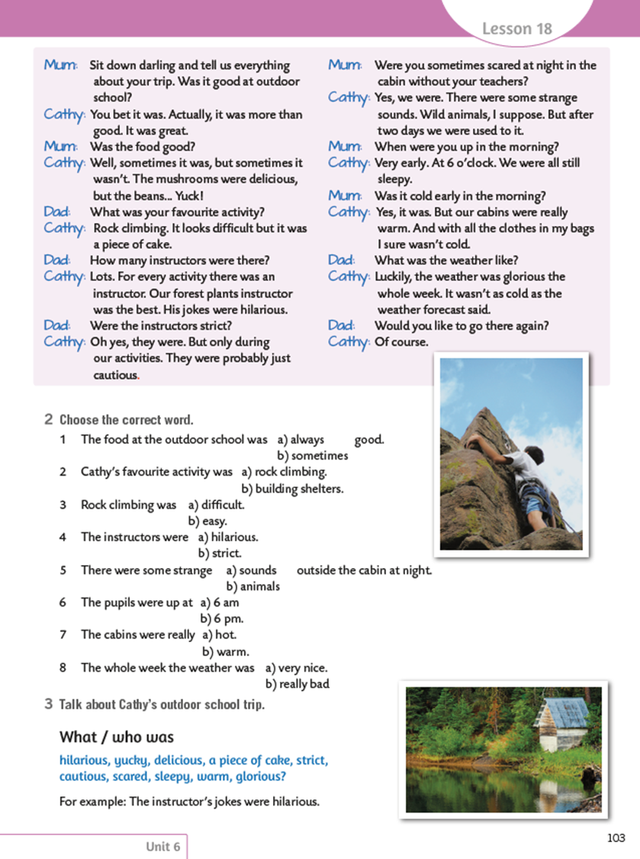
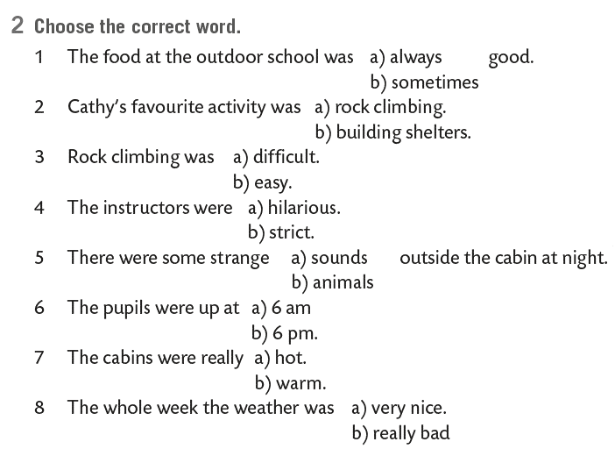

Choose the correct word.
Check here:
https://wordwall.net/resource/276006/engleski-jezik/home-again

Slide 5

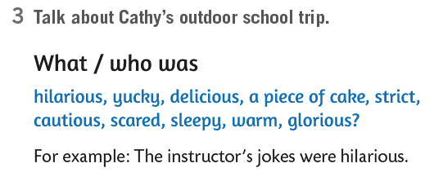
Write about Cathy’s outdoor school trip. What/who was?
The beans were yucky.
The mushrooms were delicious.
Rock climbing was a piece of cake.
The instructors were strict.
…

Slide 6
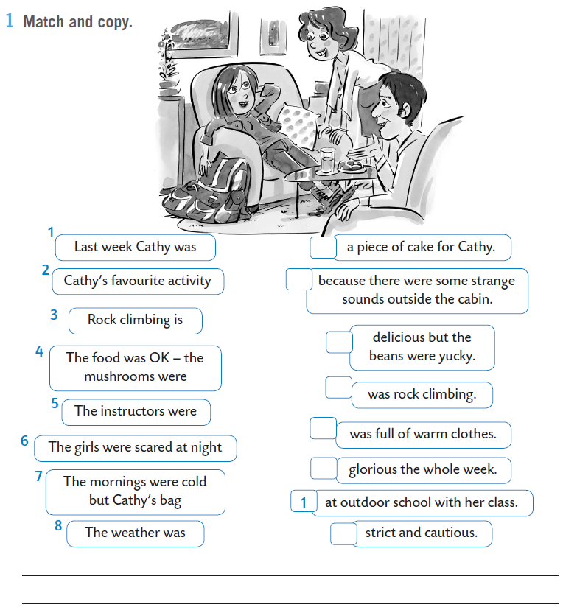
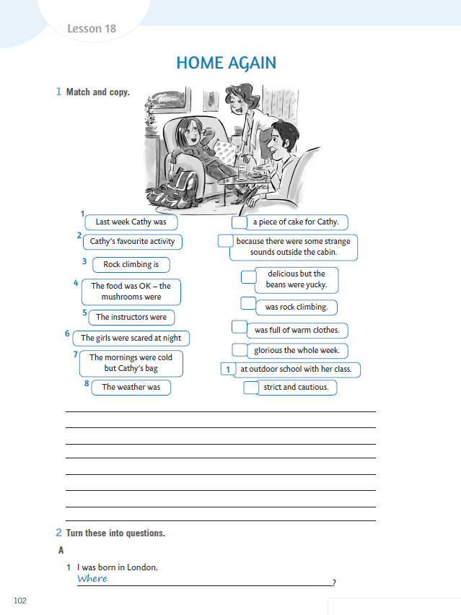
WB, page 102.
Match the begining with the end and copy.
3
6
4
2
7
8
5

Slide 7


Open your book, page 102.
Cathy is back home and her parents have got a lot of questions about her outdoor school experience.
What questions do her parents have?
Koja pitanja su joj njezini roditelji postavili?
Prisjetite se rečenice: Ben je jučer bio tužan.
Ben was sad yesterday.
Kako postaviti pitanje: Je li Ben bio tužan jučer?
Was Ben sad yesterday?
Usporedi te dvije rečenice!
Primjećuješ li da su TO BE (was/were) i subjekt zamijenili mjesta?
Kod upitnog oblika, pomoćni glagol TO BE mijenja mjesto sa subjektom, odnosno vršiteljem radnje, dok ostatak rečenice ostaje nepromijenjen.
Kako pitati KADA je Ben bio tužan?
WHEN was Ben sad?
Dakle, samo ispred pomoćnog glagola WAS/WERE dodajemo upitnu riječ WH~!

Slide 8
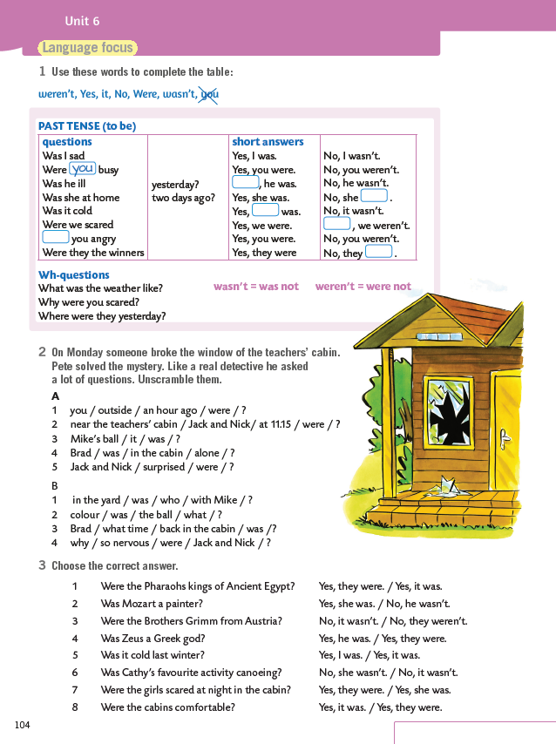
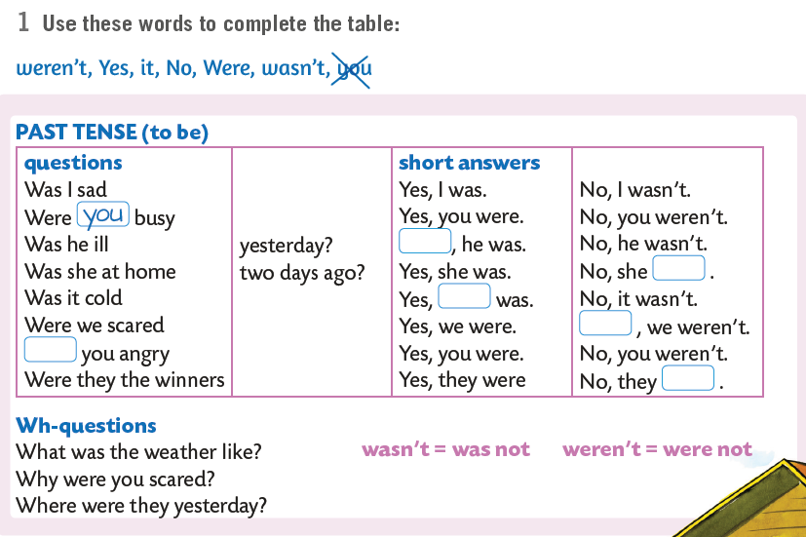
Open your book, page 104.
Fill in the table in LANGUAGE FOCUS on p.104.
Yes
wasn’t
it
No
Were
weren’t

Slide 9

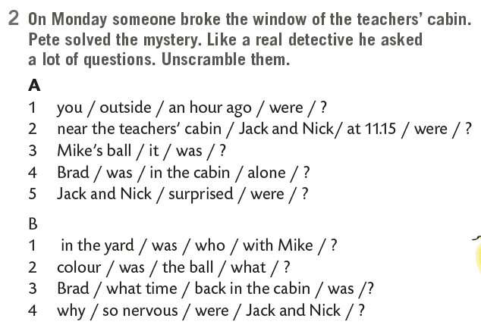
U A dijelu zadatka su YES/NO pitanja, što znači da ćeš na početak pitanja stavljati WAS/WERE, zatim subjekt i potom ostatak riječi.
U B dijelu zadatka se nalaze WH~ questions, što znači da će na početku pitanja stajati WH~ riječ, a tek potom WAS ili WERE, i zatim ostatak riječi.
A 1 Were you outside an hour ago?
2 Were Jack and Nick near the teachers’ cabins at 11.15?
3 Was it Mike’s ball?
4 Was Brad alone in the cabin?
5 Were Jack and Nick surprised?
B 1 Who was in the yard with Mike?
2 What colour was the ball?
3 What time was Brad back in the cabin?
4 Why were Jack and Nick so nervous?

Slide 10
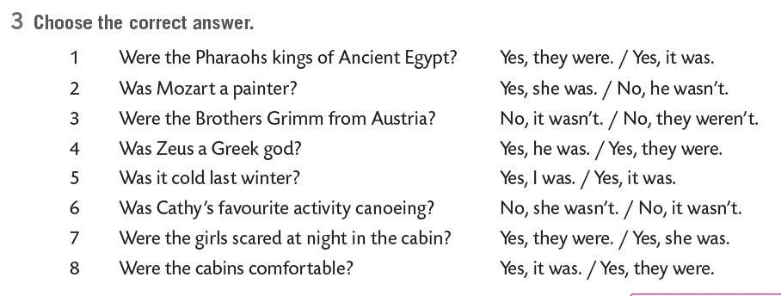



Choose the correct answer.
Practice here:
https://www.e-sfera.hr/dodatni-digitalni-sadrzaji/2d92afb2-639a-479a-9eba-cb25a93c4716/assets/interactivity/self-check_1/index.html

Slide 11
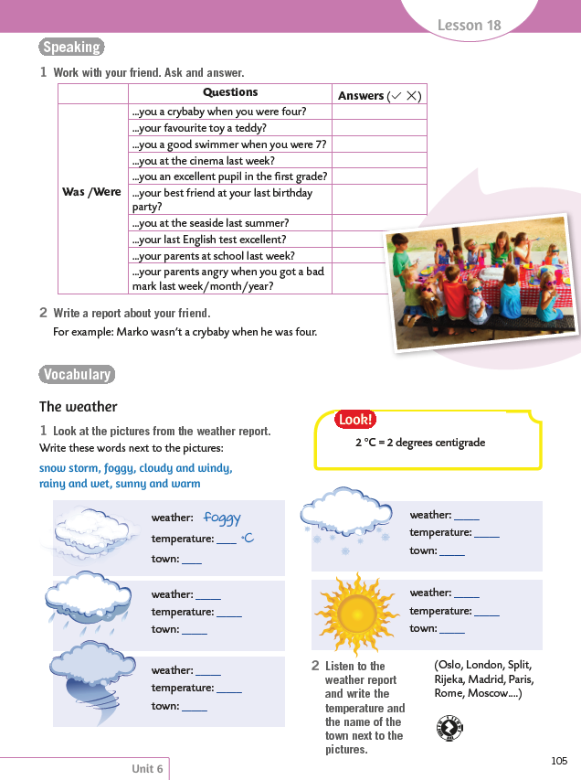
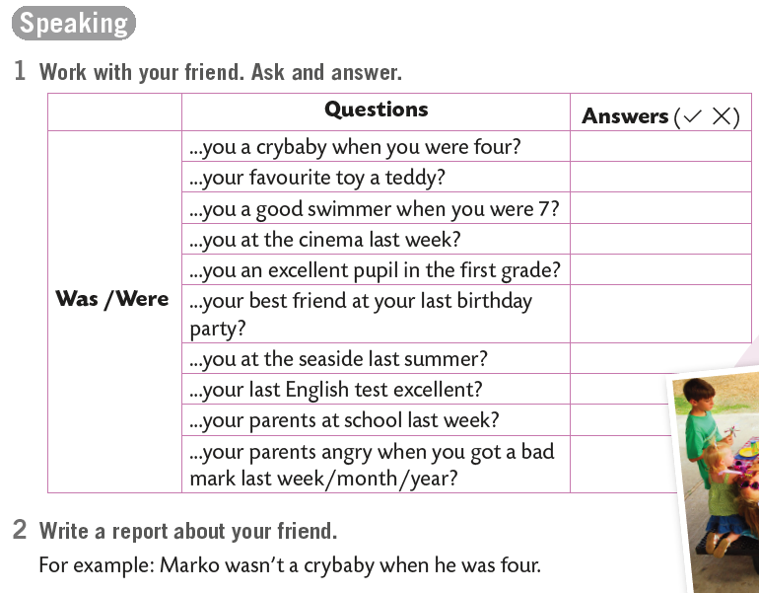
On the next page...
Work with your friend. Ask and answer. Then write a report.

Slide 12
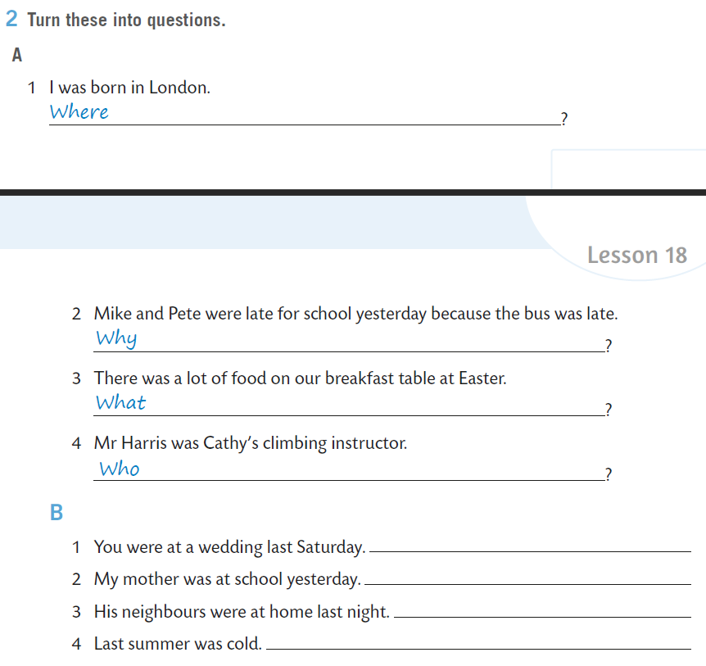
WB, page 102.
were you born
Turn into questions.
were Mike and Pete late for school yesterday
was there on our breakfast table at Easter
was Cathy's climbing instructor
Were you at a wedding last Saturday?
Was my mother at school yesterday?
Were his neighbours at home last night?
Was last summer cold?

Slide 13
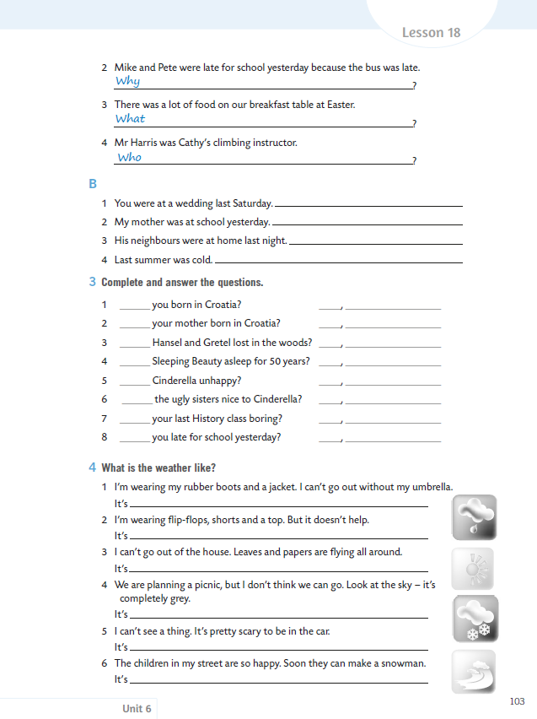
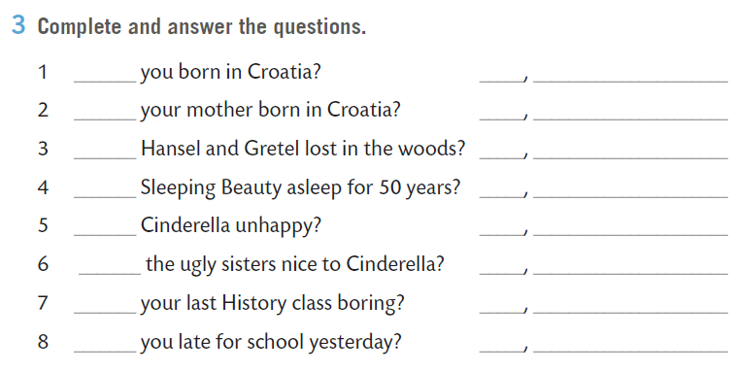
On the next page...
Complete and answer the questions.
Were
Was
Were
Yes they were.
Was
No she wasn’t
Was
Yes she was
Were
No they weren’t
Was
Were

Slide 14





What was the weather like? The weather was glorious the whole week. It wasn't as cold as the weather forecast said. Can you remember more words to describe weather? Write them down or create them here: https://wordart.com/!
cold
sunny
hot
WEATHER

Slide 15
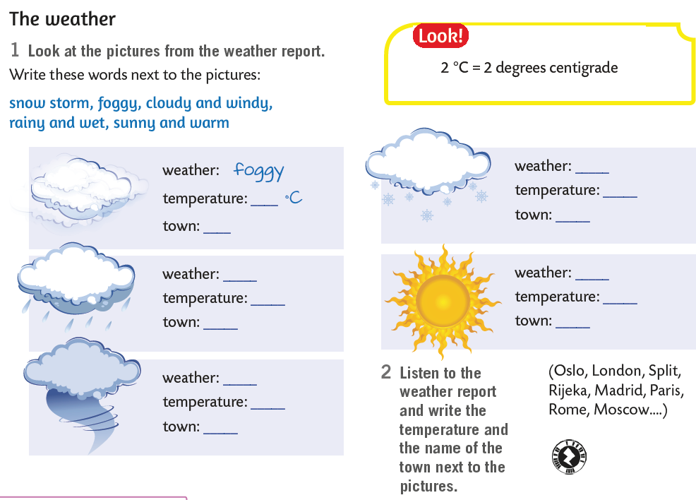
Book, page 105.
Look at the pictures from the weather report. Write the words next to the pictures.
snow storm = snježna oluja
foggy = maglovito
cloudy = oblačno
windy = vjetrovito
rainy = kišovito
wet = vlažno
sunny = sunčano
warm = toplo
snow storm
rainy and wet
sunny and warm
cloudy and windy

Slide 16
What is a WEATHER REPORT?
A weather report je izvještaj o vremenskim prilikama.
A WEATHER FORECAST je vremenska prognoza, tj. procjena očekivanih vremenskih uvjeta.
snow storm
rainy and wet
sunny and warm
cloudy and windy

Slide 17
Listen to the weather report and write the temperature and the name of the town next to the pictures.
U drugom zadatku na 105. stranici udžbenika trebaš odgledati WEATHER REPORT na sljedećoj poveznici, te nadopuniti podatke koji nedostaju, moraš spojiti grad s odgovarajućim piktogramom, te zabilježiti temperaturu u tom gradu.
Prilikom gledanja video zapisa, obrati pažnju na LOOK! Okvir i čitanje stupnjeva u engleskom jeziku – 2 degrees centigrade!
https://youtu.be/xozCOBlIohM
snow storm
12
0^{O}C
London
Oslo
rainy and wet
sunny and warm
15^{O}C
22^{O}C
Madrid
Rome
cloudy and windy
9^{O}C
Berlin

Slide 18
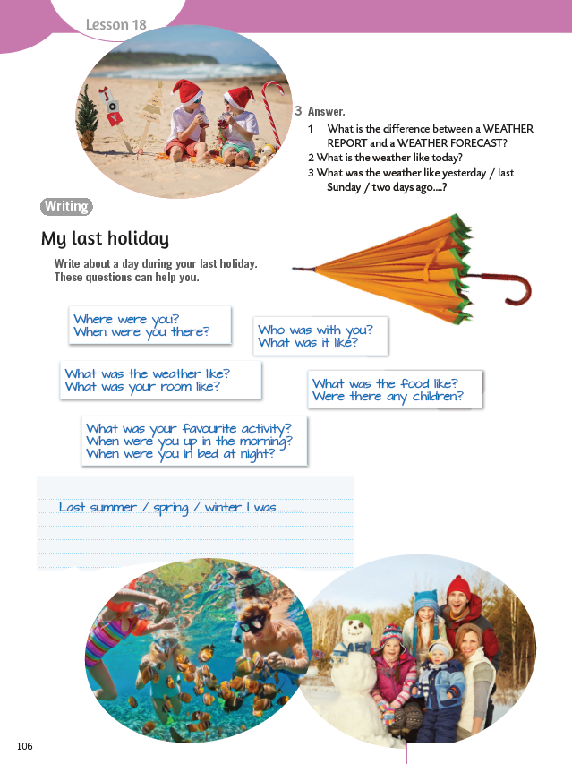
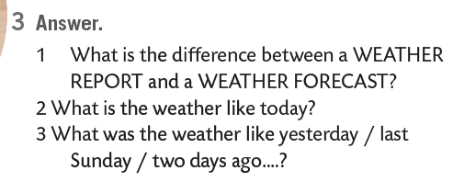
On the next page...

Slide 19
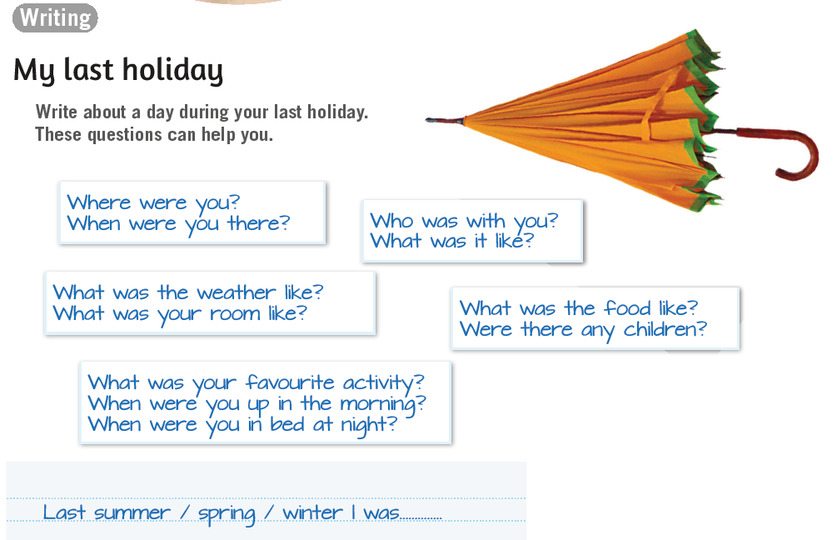
Write about a day during your last holiday. These questions can help you.
Na sljedećoj poveznici probaj pronaći 12 riječi vezanih uz vremenske prilike i vremensku prognozu:
https://wordwall.net/resource/276005/engleski-jezik/weather-find-12-words-connected-weather

Slide 20
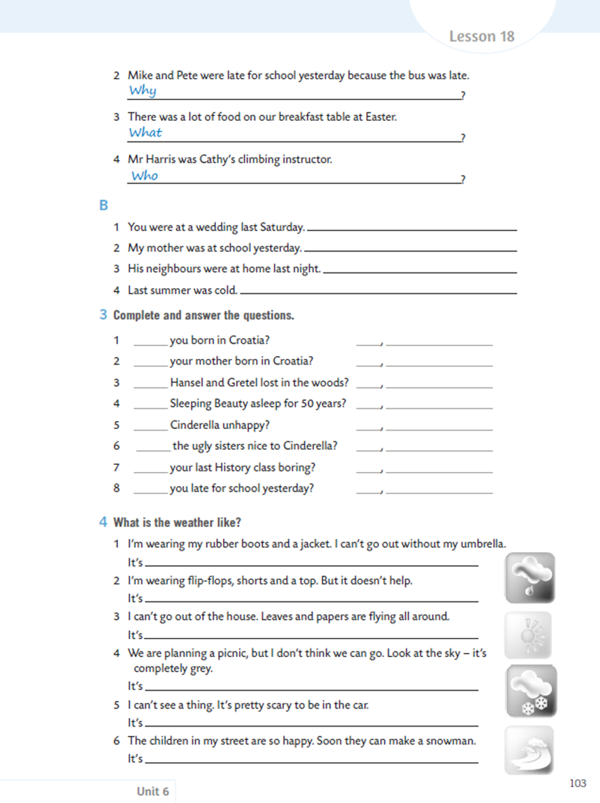
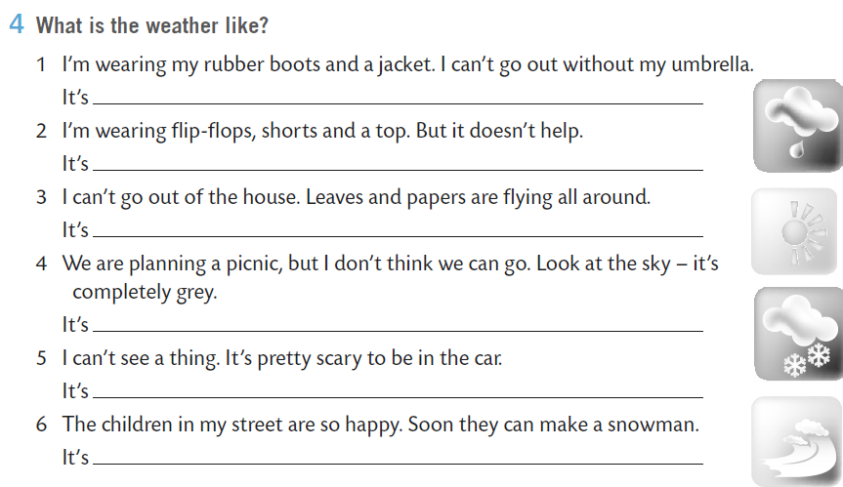
Open your exercise book, page 103.
What is the weather like?
Pročitaj rečenice i zapiši kakvo je vrijeme.
rainy and wet.
sunny and hot.
windy.
cloudy.
foggy.
snowing.

Slide 21

PROJEKTNI ZADATAK: The weather report
slijedi model WEATHER REPORTA iz udžbenika i iz videa koji si odgledao na sljedećoj poveznici:
https://youtu.be/xozCOBlIohM
prati vrijeme u 5 gradova Hrvatske i napiši izvještaj o vremenu za tih pet gradova, te potom koristeći svoj tablet ili mobitel snimi WEATHER REPORT za tih pet gradova

Slide 22
Struktura
prije nego kreneš snimati WEATHER REPORT nacrtaj kartu Hrvatske ili napravi kartu u PPT prezentaciji (upotrijebi maštu i kreativnost), označi pet odabranih gradova, te pored naziva gradova napiši temperaturu i stavi crtež / ikonicu koja prikazuje vremenske prilike
izlaganje možeš započeti rečenicom:
My name is… and this is the weather report for Croatia.
snimku svog projektnog zadatka možeš npr. završiti rečenicom:
Thank you for watching.

Slide 23
Oblik
prilikom rada na ovom projektnom zadatku upotrijebi svoju KREATIVNOST
kartu Hrvatske možeš izraditi kao plakat, prezentaciju, video, animaciju, interaktivnu prezentaciju;
a možeš za svoj WEATHER REPORT napraviti i uvodnu najavu koristeći npr. powtoon.com
na raspolaganju imaš mnoštvo različitih digitalnih alata ISKORISTI IH!

Slide 24
Vrednovanje
BODOVNA SKALA
8 – 9 bodova | odličan (5)
6 – 7 bodova | vrlo dobar (4)
4 – 5 bodova | dobar (3)
2 – 3 boda | dovoljan (2)
0 – 1 bod | nedovoljan (1)
 | RAZINE OSTVARENOSTI
 | u potpunosti (3 boda) | djelomično (2 boda) | potrebno doraditi (1 bod)
STRUKTURA | Struktura je u potpunosti u skladu s postavljenim zadatkom. | Struktura je djelomično u skladu s postavljenim zadatkom. | Elemente strukture treba doraditi. Nedostaju pojedini dijelovi strukture.
VOKABULAR | Učenik koristi širok raspon vokabulara i ne griješi prilikom izgovora struktura. | Učenik koristi ciljani vokabular, ali povremeno griješi prilikom izgovora određenih struktura. | Učenik koristi samo jednostavan vokabular i ima mnoštvo pogrešaka u izgovoru zadanih struktura.
CILJ | Cilj je naveden i u potpunosti ostvaren! | Cilj nije u potpunosti ostvaren u odnosu na sadržaj! | Cilj nije ostvaren u odnosu na sadržaj!
Ako sastavnica nije ostvarena niti na najnižoj očekivanoj razini ili ne postoji tada se za nju dodjeljuje 0 bodova.

